Slide 1


Star Schemas
An Introduction to

Slide 2
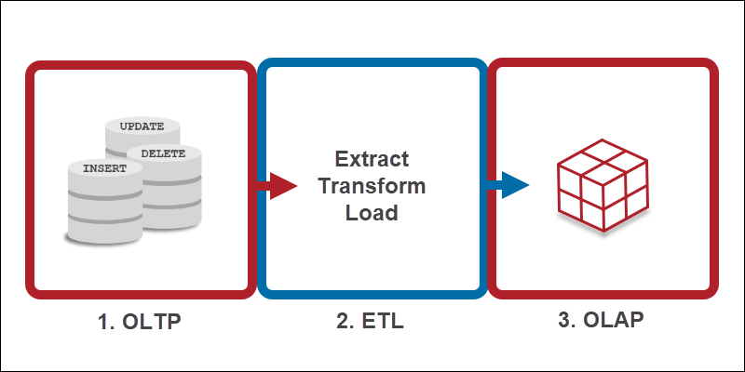
Background: OLTP vs OLAP
OLTP = Online Transaction Processing
Optimized for transactional processing and real-time updates
Used to manage day-to-day business operations involving individual transactions
Used for real-time processing of online transactions at scale, such as reservation systems and online sales
Designed to quickly process tons of small-scale transactions in real time
OLAP = Online Analytical Processing
Optimized for complex data analysis and reporting
Used by data scientists, business analysts, and knowledge workers to analyze large data sets from multiple perspectives
Systems support business intelligence (BI), data mining, and other decision support applications
Designed to handle complex queries for rapid analysis

Slide 3
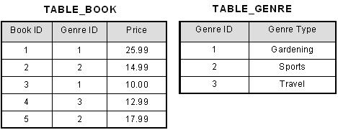
Background: Normalization
OLTP
Normalization applied to minimize data redundancy and ensure data integrity
Prioritize consistent, real-time transactional processing through highly normalized, third normal form (3NF) tables
OLAP
Use a denormalized structure, such as a star schema, to optimize complex analytical queries
Prioritize rapid query performance for historical data analysis by using denormalized structures to reduce joins and complex calculations
3NF example:

Slide 4
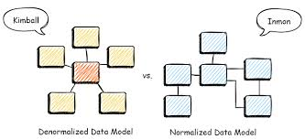
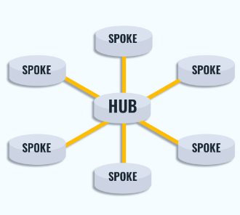
Background: Popular Data Modeling Approaches
Kimball
Bottom-up approach (data marts first) that focuses on business processes and needs
Uses star schemas
Quick development of useful data structures is the highest priority
Good for quick development, ease of use, and tailored data for specific business units
May have limitations in scalability, flexibility, and historical data management
Inmon
Top-down approach (EDW first) that emphasizes data and is good for organizations that need a single source of truth for complex reporting
Uses 3NF schema
Data consistency is the highest priority
Can be complex to add multiple tables to the data model
Requires skilled resources that can be expensive and hard to find
Data Vault
Hybrid approach that combines elements of both Kimball and Inmon
Uses hub-and-spoke schema
Hub: entity of interest
Spoke/satellite: historical metadata
Link: connect hubs through a defined relationship
Speed of both development and run time is the highest priority
Focuses on the relationships between data and is good for organizations that need scalability, agility, and raw data storage
Designed to handle changes and additions to the data model with minimal impact on existing structures
Notes:
As proposed by Ralph Kimball, the bottom-up method calls for the creation of many data marts to satisfy the analytical needs of departments, followed by virtual integration of these data marts for consistency through an information bus.
In the perspective of Bill Inmon, the first step should be to create a consolidated enterprise-wide data warehouse. This can be made by connecting numerous databases to the analytical needs of departments, which are later referred to as data marts. As a result, this method is known as the top-down approach.
Hubs: hubs are entities of interest to the business. They contain just a distinct list of business keys and metadata about when each key was first loaded and from where.
Links: links connect Hubs and may record a transaction, composition, or other type of relationship between hubs.
Satellites: satellites connect to hubs or links and store metadata about when the data were loaded and from where. They great for versioning and doing historical analysis.
Use Inmon if…
Data accuracy is the most important characteristic of your warehouse
You have time/resources to do a lot of upfront work
Use Kimball if…
If you business requirements are well-defined and stable
You are querying lots of data often
Use a Data Vault if…
Your business goals change often
You need version-control inherently built into your infrastructure
Difference between star schema and data vault:
Data vault architecture
Data vault uses a modular approach to data warehousing. It's designed to be flexible and scalable, and to integrate data from multiple sources. Data vault is meant to be complementary to star schema, acting as an intermediary between staging and reporting layers.
Star schema architecture
Star schema is a dimensional model that organizes data into a structure that improves analytical query performance. It's often used in the presentation layer, where refined data is ready for business intelligence.

Slide 5

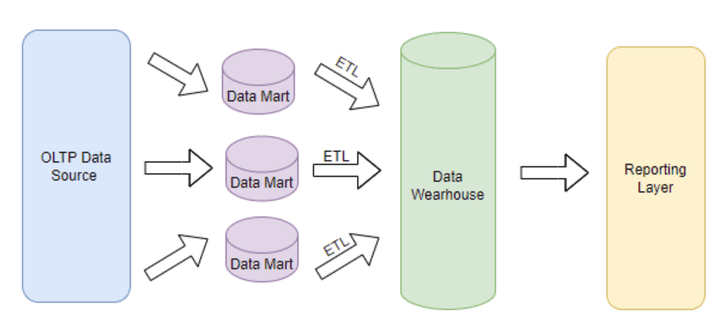
Why Kimball?
Use Kimball if…
Your business requirements are well-defined and stable
You are querying lots of data often
Agility and faster delivery
Bottom-up development: allows for faster initial delivery of value to a specific department, with the system expanding incrementally over time
Scalability: can add new business processes (and their star schemas) without redesigning the entire system
Consistency and governance
Conformed dimensions: creates a single, consistent version of the truth, allowing for reliable cross-departmental analysis
Reliable history tracking: provides a comprehensive history for analysis
Adaptability to the modern data stack
Compatibility with modern BI tools: easy to create reports and dashboards
Integration with modern architectures: While developed decades ago, Kimball's principles remain relevant and are adapted for modern cloud data warehouses and data lakehouses. Tools like dbt support the creation of Kimball-style dimensional models within ELT workflows
User-centric and intuitive design
Business-driven: final product is relevant and useful to decision-makers
Simple: easy for non-technical users to understand and navigate
High-performance queries
Faster retrieval: optimized for high-volume analytical queries
Efficient joins: simple joins between fact/dims are highly efficient and performant, especially on modern cloud data warehouses.

Slide 6
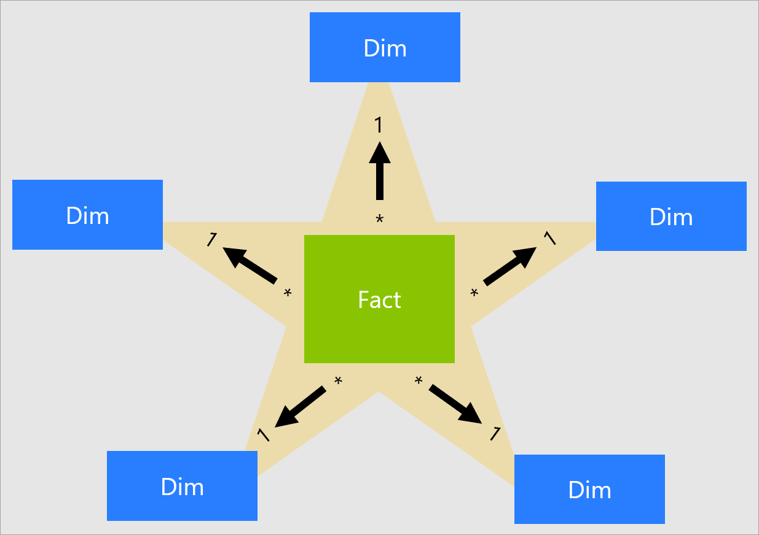
What is a Star Schema?
A star schema is a data modeling technique that organizes data into a central fact table containing measurable business metrics and surrounding dimension tables that provide descriptive context. This structure, resembling a star, simplifies data analysis by reducing the number of joins needed for queries, leading to faster read performance and easier user comprehension for reporting and business intelligence

Slide 7
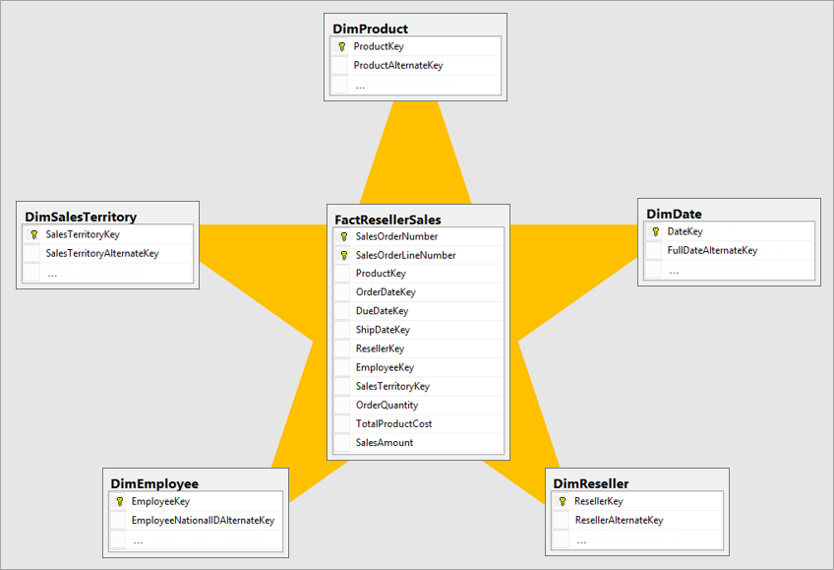
Star Schema Characteristics
Core Components
Fact Table(s): Located at the center, this table holds quantitative data, such as sales figures, quantities, or revenue, along with foreign keys that link to the dimension tables.
Dimension Tables: These tables surround the fact table and contain descriptive attributes that provide context to the facts. Examples include product details (name, brand, category), customer information (name, location), and date attributes (day, month, year).
Structural Characteristics
Denormalized structure: Unlike a transactional database, a star schema's dimension tables are denormalized, meaning they contain some redundant data. This reduces the number of joins needed to retrieve data, making queries faster.
Simple, single-level relationships: The model has a simple, non-hierarchical structure. All dimension tables are connected directly to the fact table, creating simple one-to-many relationships.

Slide 8
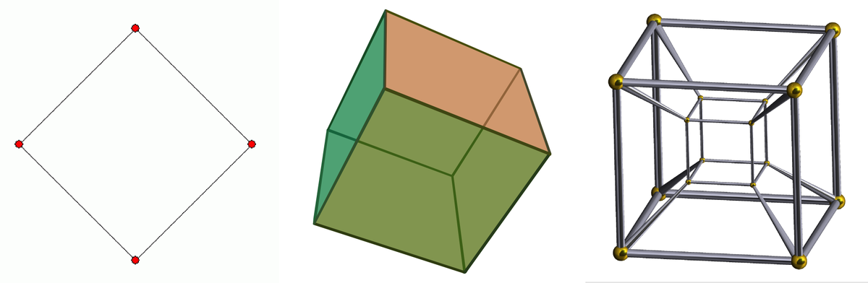
Dimensions (dims)
Some of the most common types of dimension tables are:
Calendar Date Dimension (dim date)
A special type of dimension that can be used to represent dates with a granularity of a day. The date dimension can include other attributes like the week of the year, or flags representing work days, holidays, etc. It could also include special rows representing not known dates, or yet to be defined dates. The date dimension should be initialized with all the required dates, say the next 10 years of dates, or more if required, or past dates if events in the past are handled.
Junk Dimension
A junk dimension is a cartesian product of every possible combination of values for a set of attributes. It usually consists of attributes that do not belong in the fact table or in any of the existing dimension tables.
Slowly Changing Dimension (SCD)
A slowly changing dimension is a set of data attributes that change slowly over a period of time rather than changing regularly e.g. address or name. These attributes can change over a period of time and that will get combined as a slowly changing dimension.
The 3 most common types of SCDs are:
Type 0 (Retain original)
No history is saved. Data remains static
Type 1 (Overwrite)
Old values are overwritten with new values. No historical data is saved.
Type 2 (Add new row)
A new row is created with either a start date / end date or a version for a new value. This creates history.

Slide 9
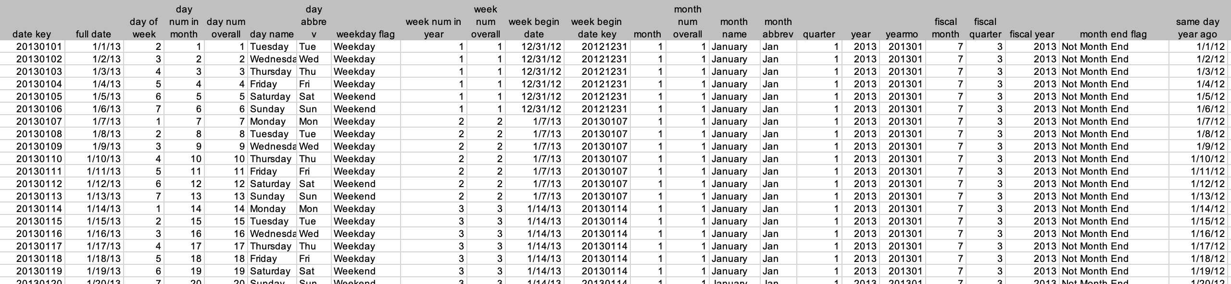
Dimension Example: dim_date

Slide 10
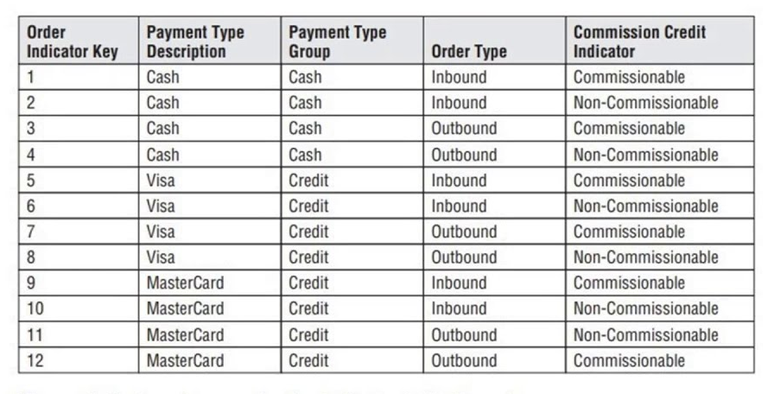
Dimension Example: Junk Dimension (dim_order)

Slide 11
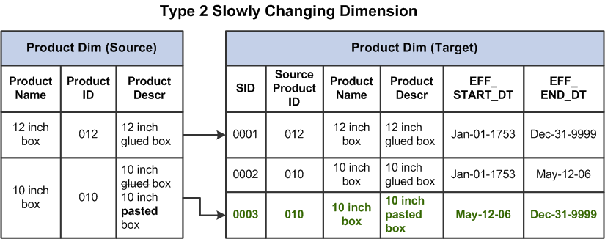
Dimension Example: SCD (type 2)

Slide 12

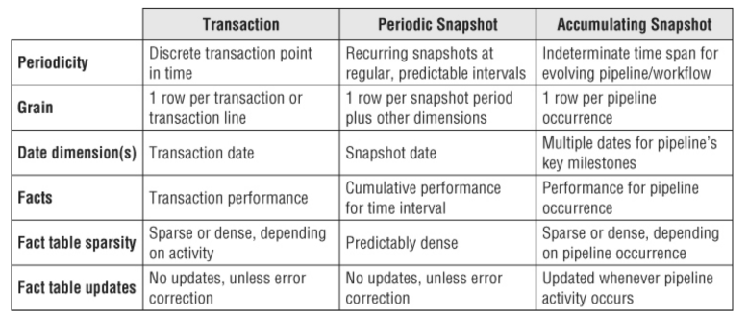
Facts
The 3 most common types of fact tables are:
Transactional
The most basic type of fact table, which records individual events such as sales transactions or website clicks.
Periodic Snapshot
Captures the status of a process at regular intervals, such as daily or monthly sales totals. For example, a daily snapshot of inventory levels for each product in a warehouse.
Accumulating Snapshot
Shows the progression of a process over time, such as the stages of an order fulfillment process. For example, an order processing accumulating snapshot records are revisited and overwritten as the process progresses.

Slide 13
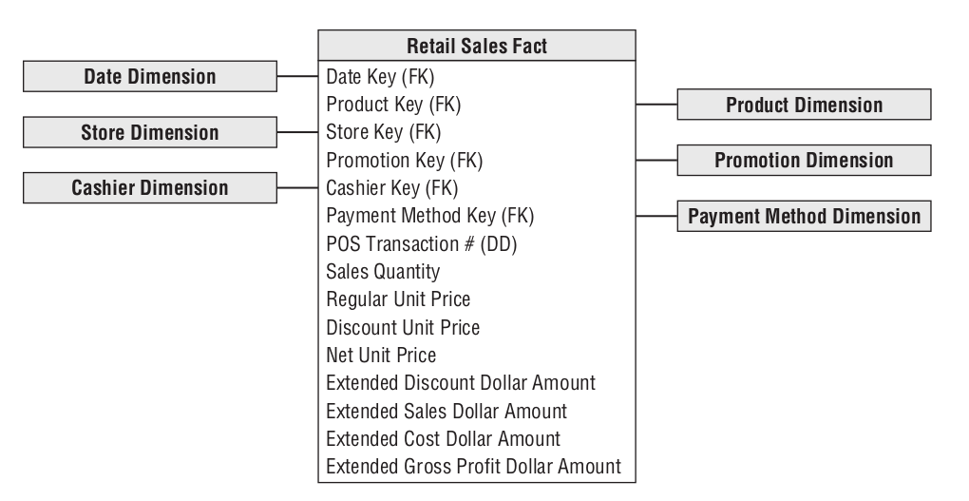
Fact Example: Transactional
Grain: one row per transaction or transaction line
Tend to be unpredictably and sparsely populated
Can be very large (billion/trillion+ rows)

Slide 14
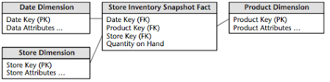
Fact Example: Periodic Snapshot
Grain: the period of time, not the individual transaction.
One row summarizes many measurement events occurring over a standard period (day, week, etc)
A row is inserted even if no activity takes place during the event (containing 0 or null)

Slide 15
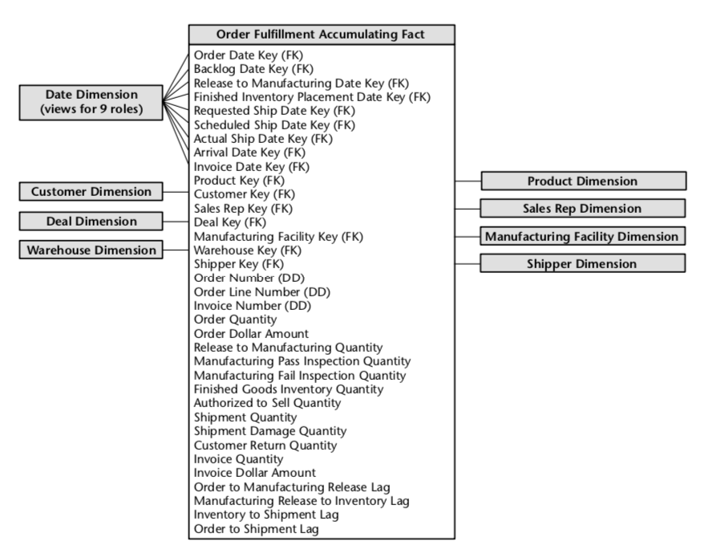
Fact Example: Accumulating Snapshot
Grain: order or order line
A row summarizes the measurement events occurring at predictable steps between the beginning and end of a process
As the pipeline progresses the fact table row is updated and revised

Slide 16
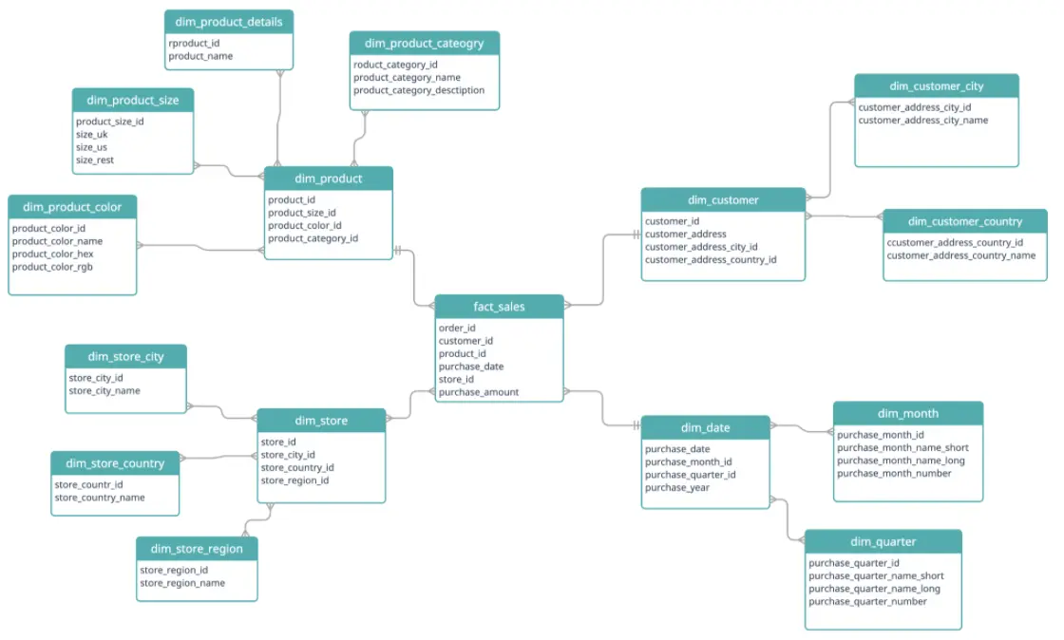
Star Schema vs Snowflake Schema
A snowflake schema is an extension of the star schema that normalizes dimension tables into more detailed, smaller tables, resembling a "snowflake". This normalization reduces storage needs, improves data integrity, and is better for complex data, but it requires more joins, which slows down queries.
Use snowflake schema for managing large, complex datasets where data accuracy, storage efficiency, and adaptability to complex analytical needs are more important than query speed.
Note: Kimball recommends avoiding snowflakes because it is difficult for business users to understand and navigate snowﬂakes. They can also negatively impact query performance. A ﬂattened denormalized dimension table contains the exact same information as a snowﬂaked dimension.

Slide 17

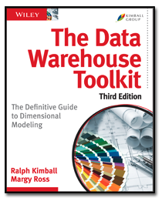
Questions?
For more information on the Kimball methodology see:
The Data Warehouse Toolkit

